Slide 1
Chapter 8

Slide 2
Objectives

Slide 3
Objectives (cont.)

Slide 4
Objectives (cont.)

Slide 5
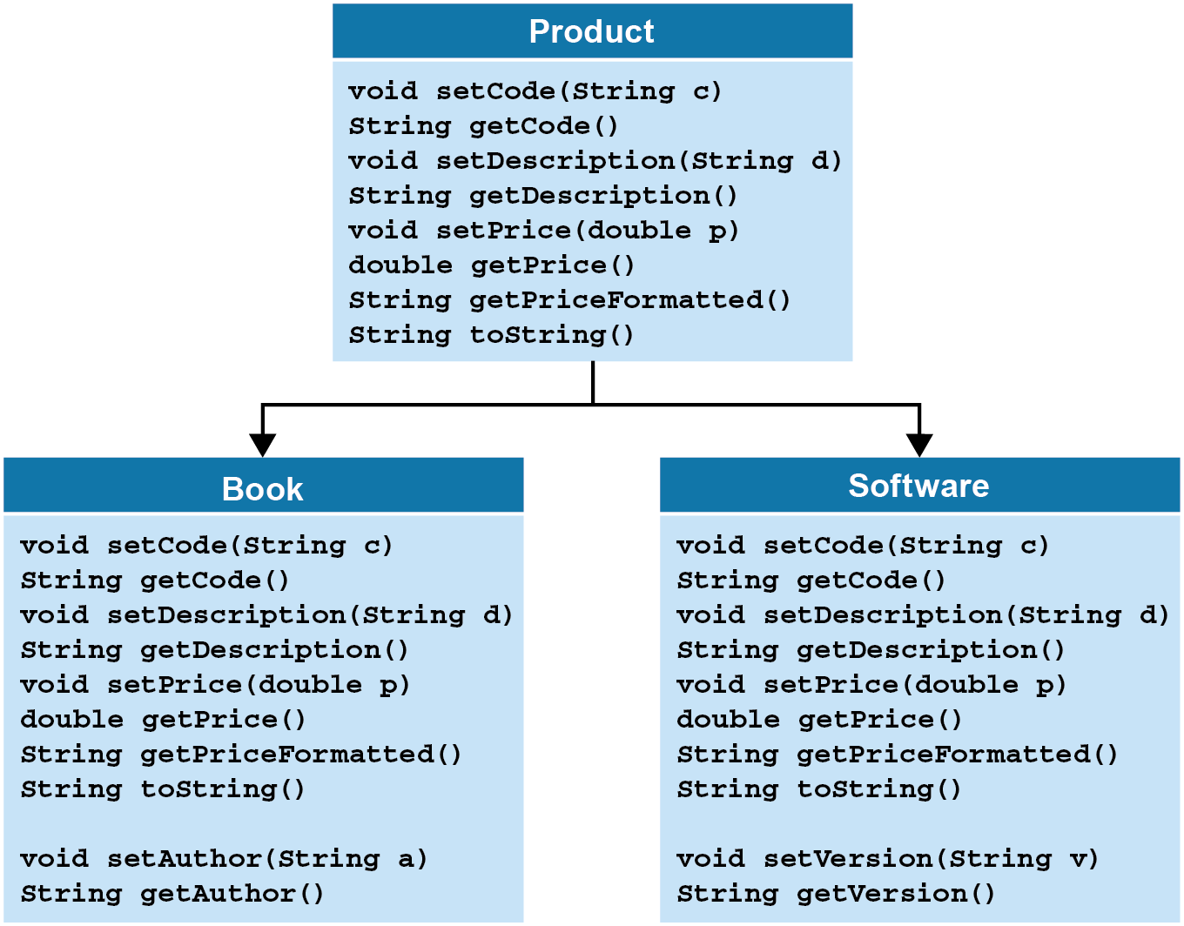
Business classes for a Product Manager application

Slide 6
The Object class

Slide 7
A typical value returned by a Product object’s…

Slide 8
Access modifiers

Slide 9
An annotation for overriding a method

Slide 10
The code for the Product superclass

Slide 11
The code for the Product superclass (cont.)

Slide 12
The syntax for creating subclasses

Slide 13
The code for a Book subclass

Slide 14
The code for a Book subclass

Slide 15
The toString() method in the Product superclass

Slide 16
Code that uses the overridden methods

Slide 17
The console for the Product application

Slide 18
The console for the Product application (cont.)

Slide 19
The code for the Product class

Slide 20
The code for the Product class (cont.)

Slide 21
The code for the Product class (cont.)

Slide 22
The code for the Book class

Slide 23
The code for the Software class

Slide 24
The code for the ProductDB class

Slide 25
The code for the ProductDB class (cont.)

Slide 26
The code for the ProductApp class

Slide 27
The code for the ProductApp class (cont.)

Slide 28
Code that casts Product and Book objects

Slide 29
Code that checks an object’s type

Slide 30
How the equals() method of the Object class works

Slide 31
The equals() method of the Product class

Slide 32
The equals() method of the LineItem class

Slide 33
An abstract Product class

Slide 34
A class that inherits the abstract Product class

Slide 35
A final class

